Slide 1


How real is your reality? Pieter Barkema | Brain Scientist Queen Square Institute of Neurology, UCL
Notes:
Thank you… Introduction…
About the movie theater, want to answer three questions.

Slide 2
The movie: is what we see real?
The viewer: how does our brain see?
The remake: are robots human-like?
Menti.com | use code 2284 8471
Notes:
These three questions.
- website: code

Slide 3
Notes:
First question…
Who thinks everyone is real?
Light, eyes, brain. So, it’s all the same?

Slide 4
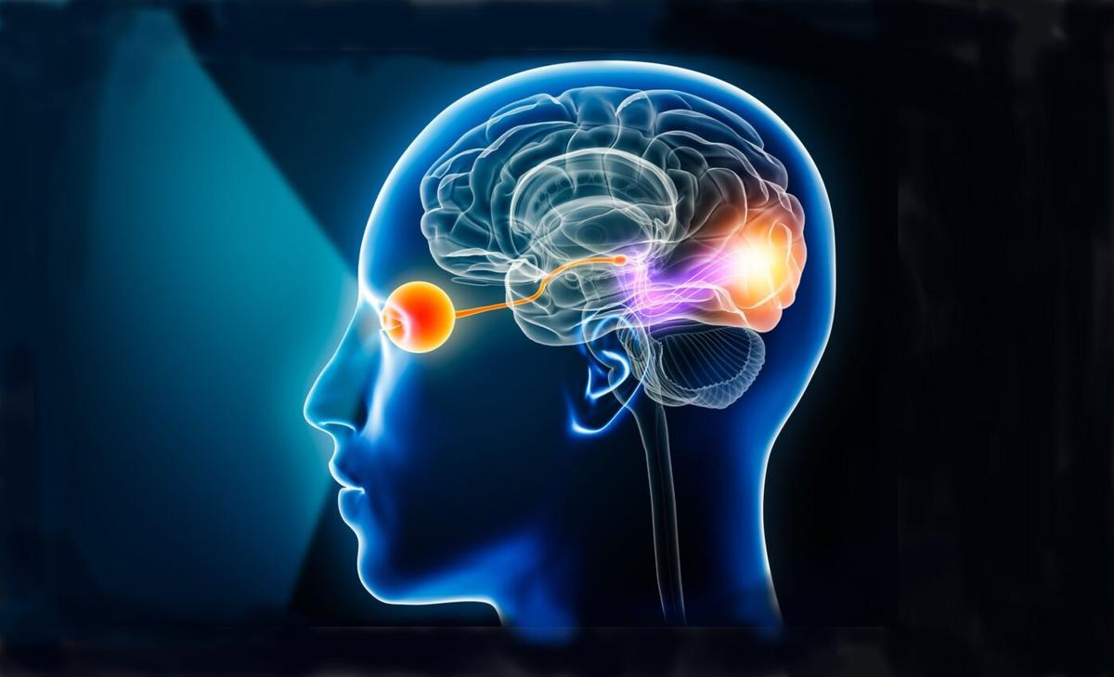
Notes:
Like a movie projector
So, we should all see the same right?

Slide 5
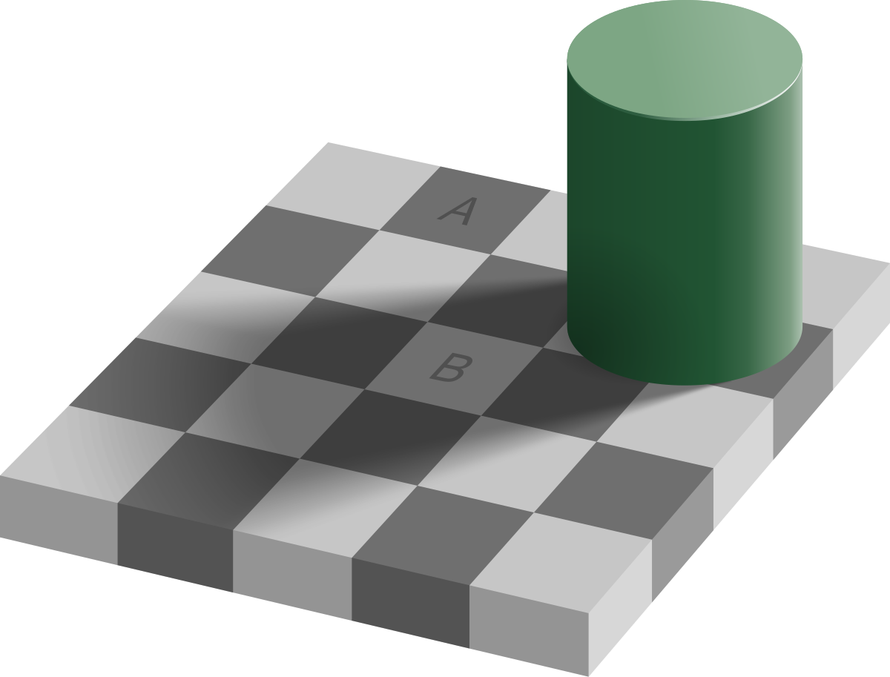
Notes:
…Introduce
Poll: A or B?
I think we all agree
No spoilers
But now I’m putting a bar of the same colour to connect the two…

Slide 6
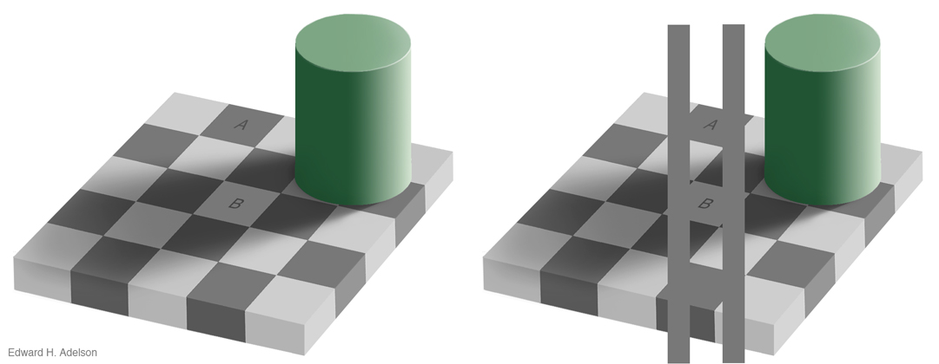
Notes:
… and now they are the same colour!
So adding extra information, changes them.
Let me show them next to each other…

Slide 7
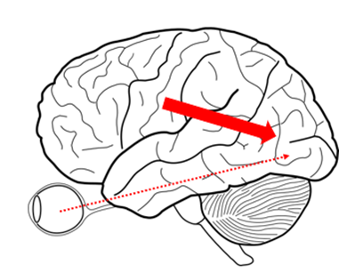
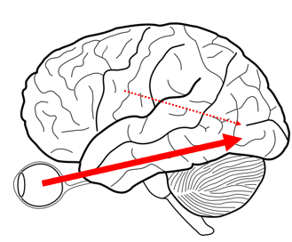

Notes:
… It is almost unbelievable right?
Even after I show you both at the same time, your eyes on the left still see B lighter than A, even though it’s the same picture as the right.
Context
Expectations versus reality stream
Scary right?

Slide 8
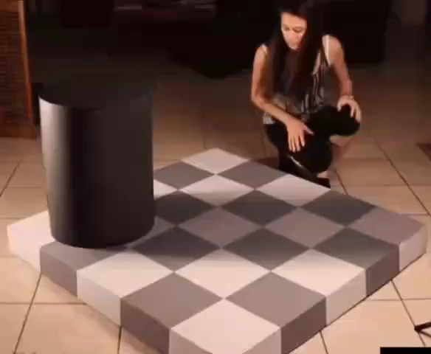
Notes:
Let’s look at another one that is really crazy.
Introduce.

Slide 9
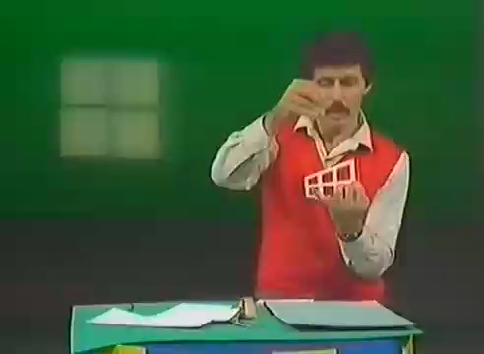
Notes:
… Show ames window is smaller/larger.
Say our brain will show us something impossible
Show video
Unbelievable, right? So how can we trust our brain?

Slide 10
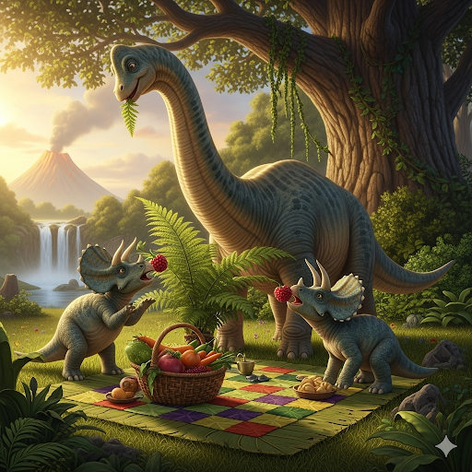
Notes:
…That’s scary, but most things are still real. Dinosaurs.
We have survived for who knows how long as animals, eating, touching. We’re fine.
So our brain is doing something right… How does it do all this?

Slide 11
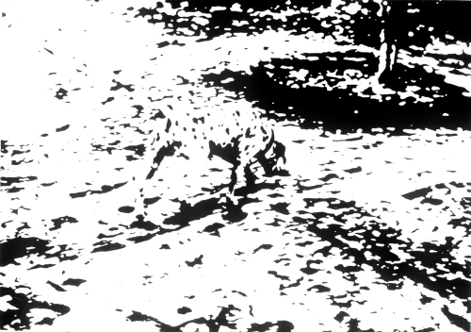
Notes:
Poll: What do we see? If you know it don’t spoil
Now I’m going to give you a bit of a hint…

Slide 12
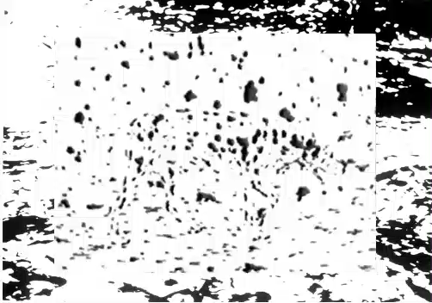
Notes:
Changing your expectations

Slide 13

Notes:
Expectations change!
So, we can learn and get closer to reality!
But maybe you are not sure yet…

Slide 14
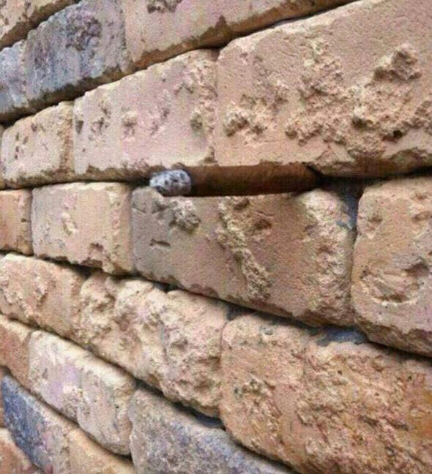
Notes:
… What do you see in this wall?
Poll
This adult candy that you should never use.

Slide 15
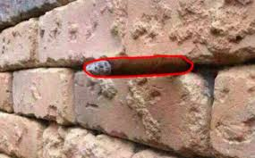
Notes:
- Poll: What we we seeing here?
- We can change our sight by learning! Pretty big deal
- Our brain is like a guessing computer

Slide 16
Notes:
- Poll: What we we seeing here?
- We can change our sight by learning! Pretty big deal
Changing the big arrow of expectations
So summing up…

Slide 17
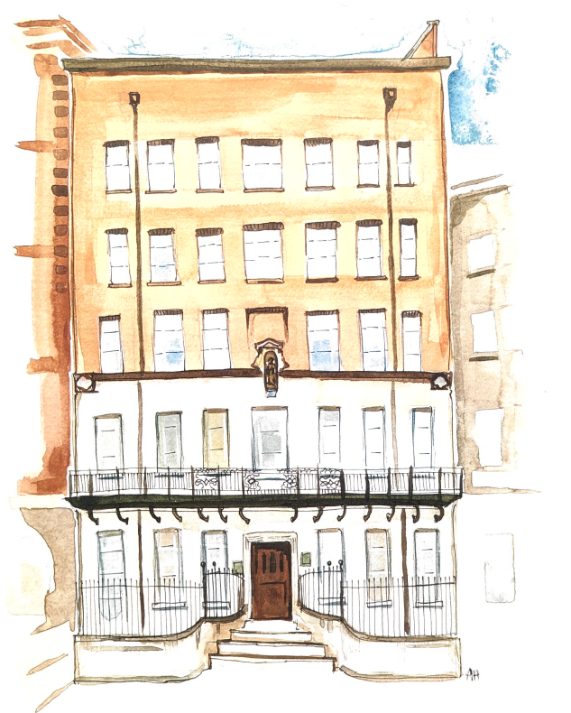
Notes:
Queen square 12
Brain scanners & example study

Slide 18
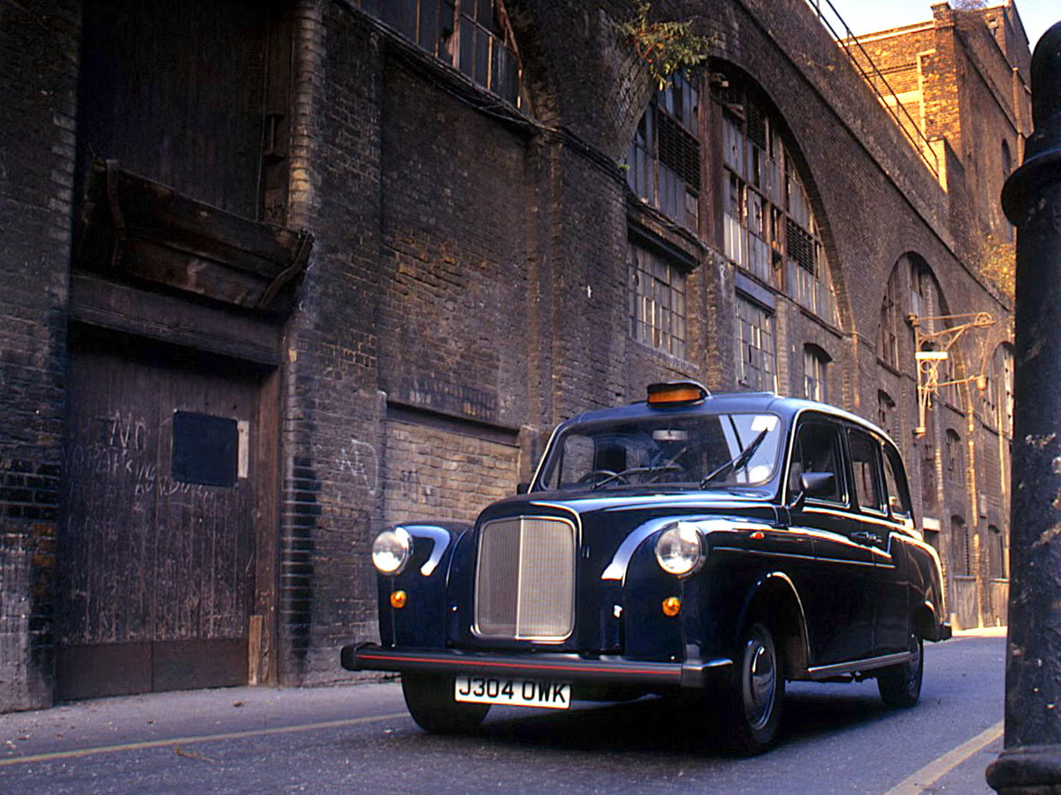
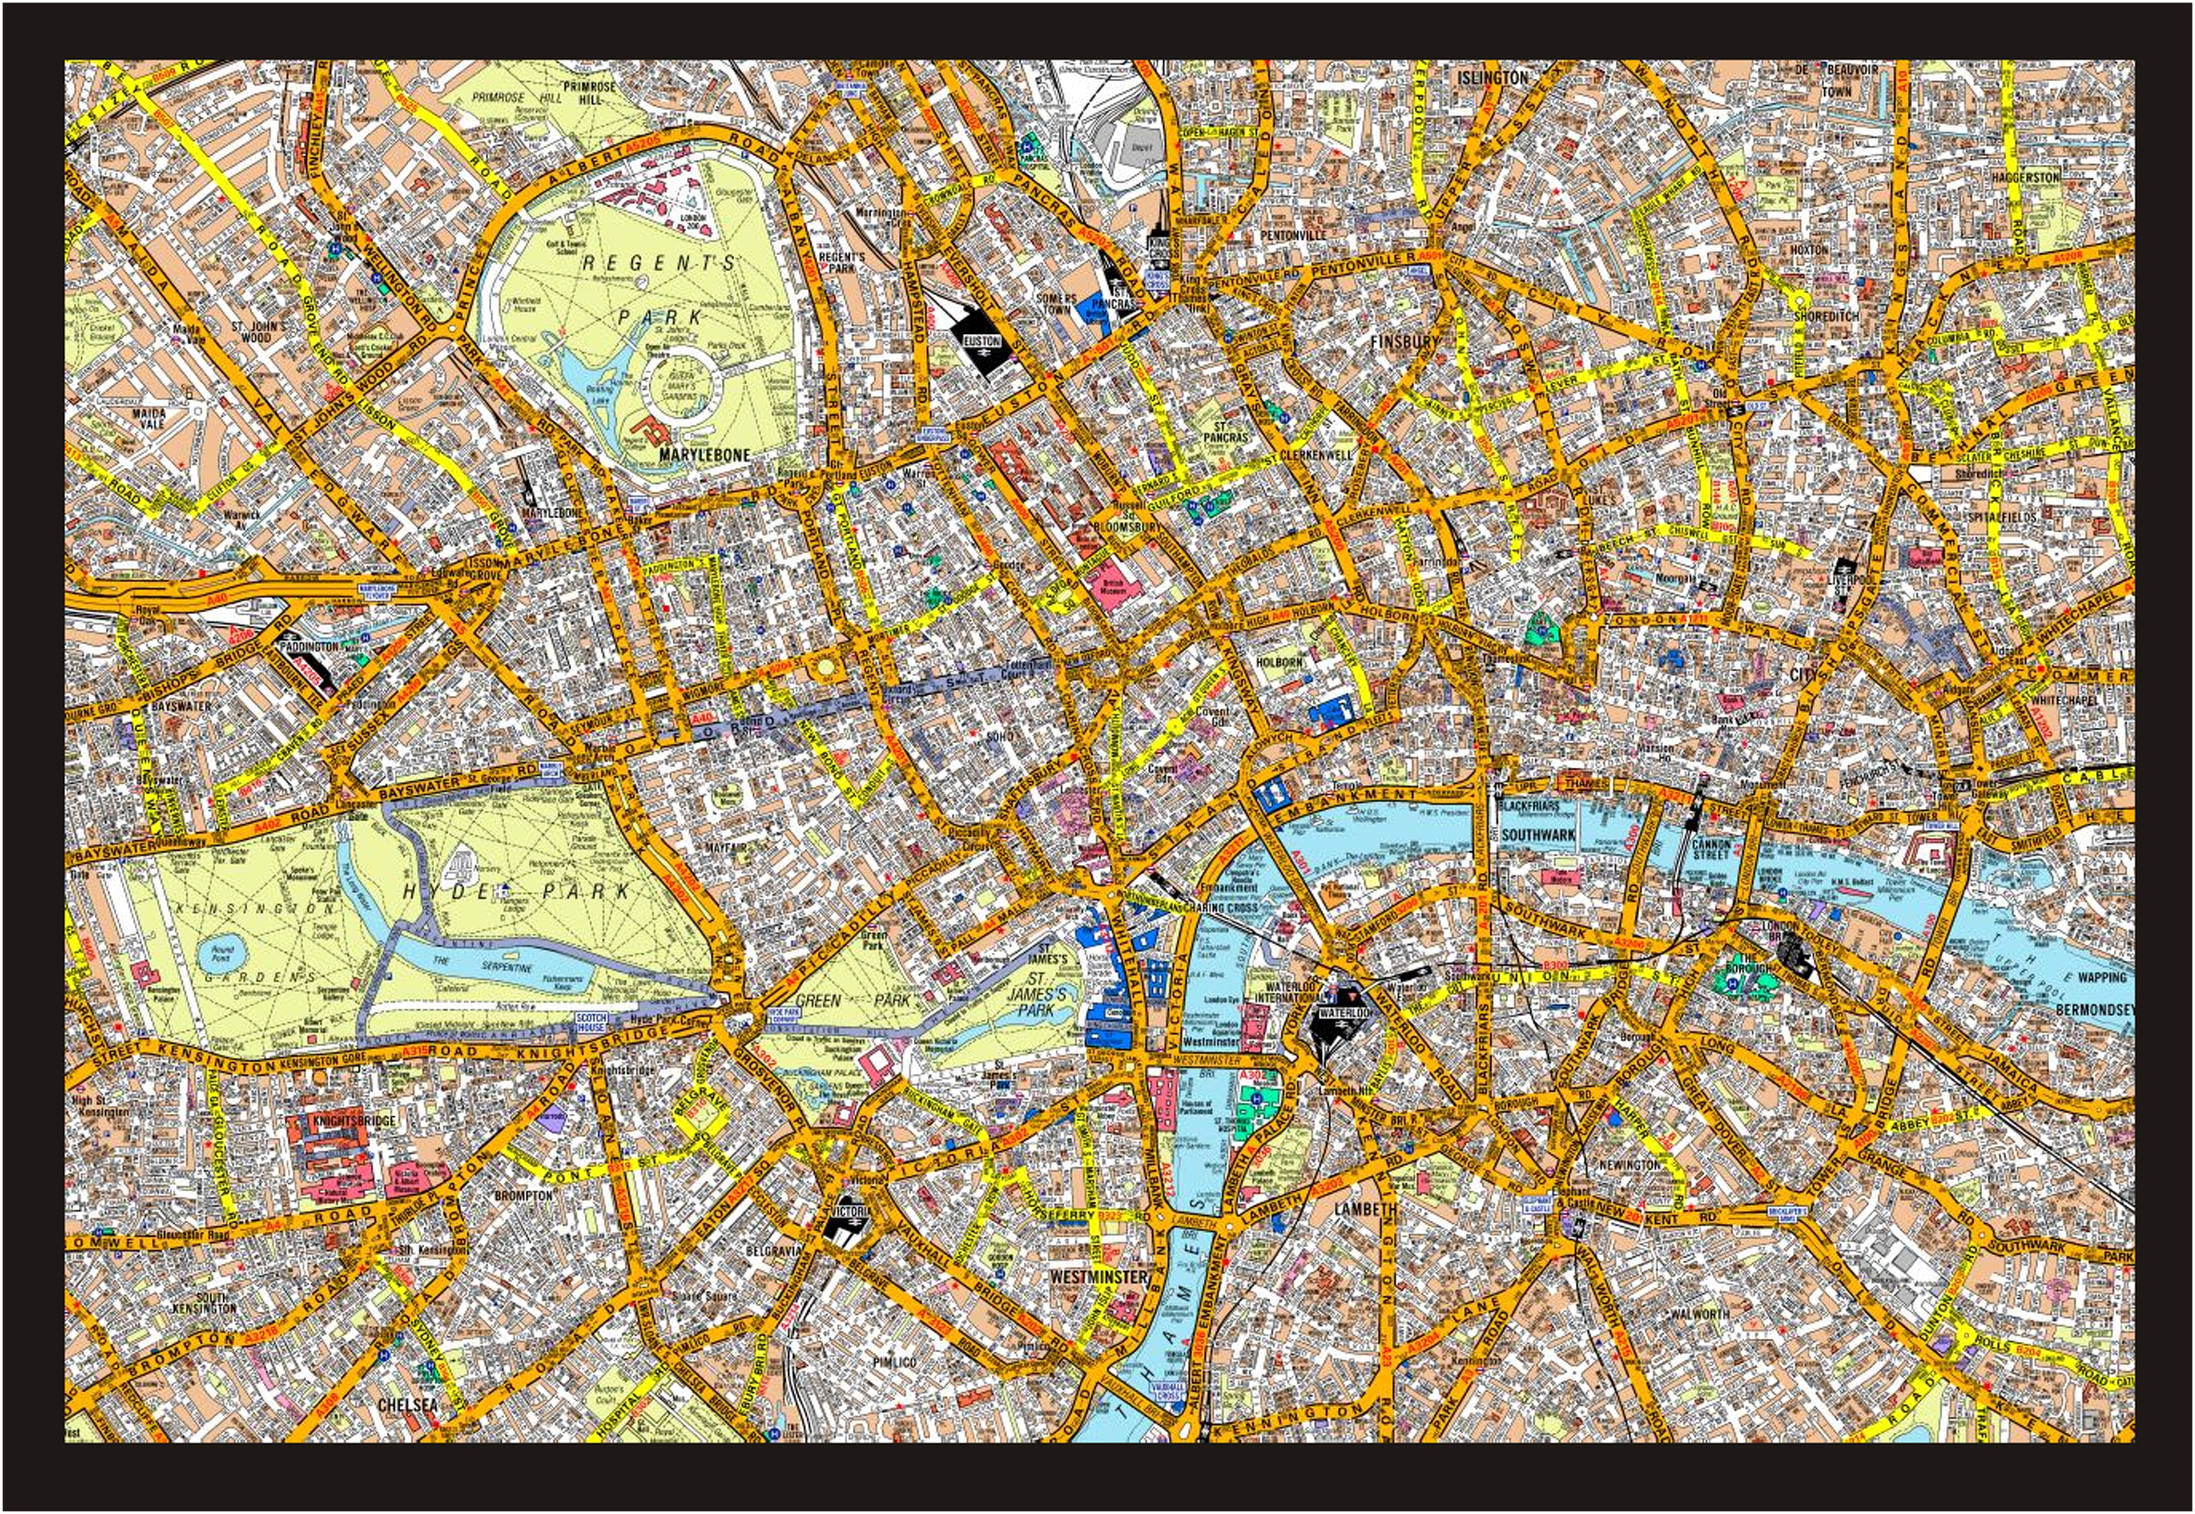
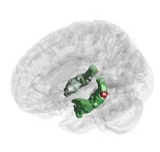
Notes:
Taxi driver…
One more study: pingpong

Slide 19
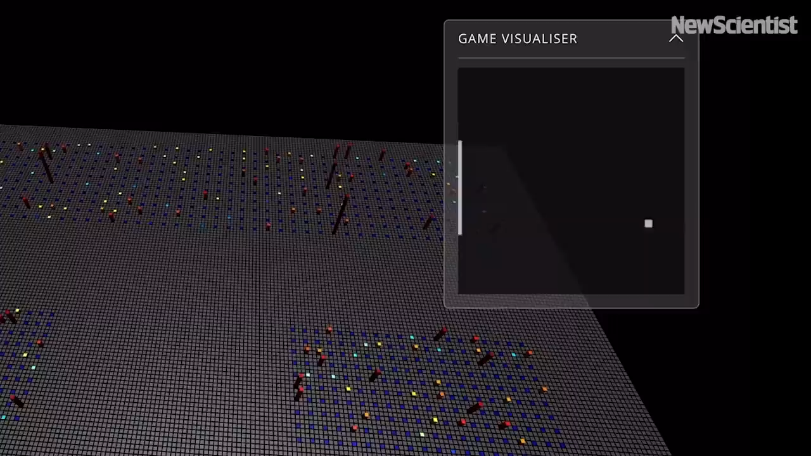
Notes:
Pingpong
So, we cannot usually look into people’s heads: mri

Slide 20
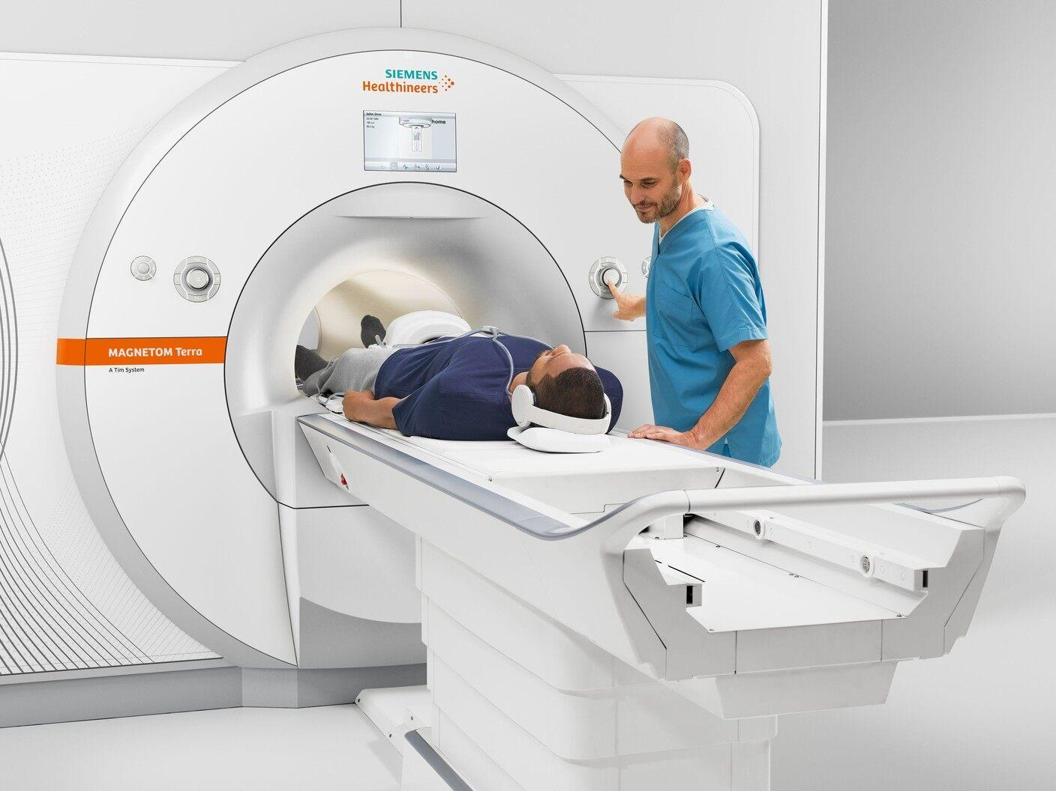
Notes:
MRI machines
… OPM

Slide 21
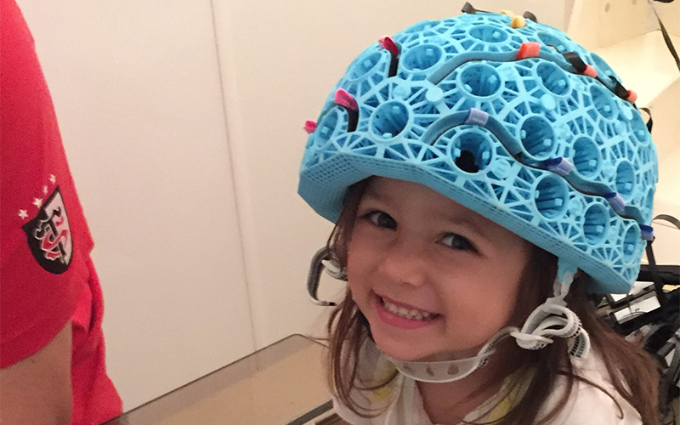
(OPM helmets)
Notes:
OPM…
Guessing computer

Slide 22
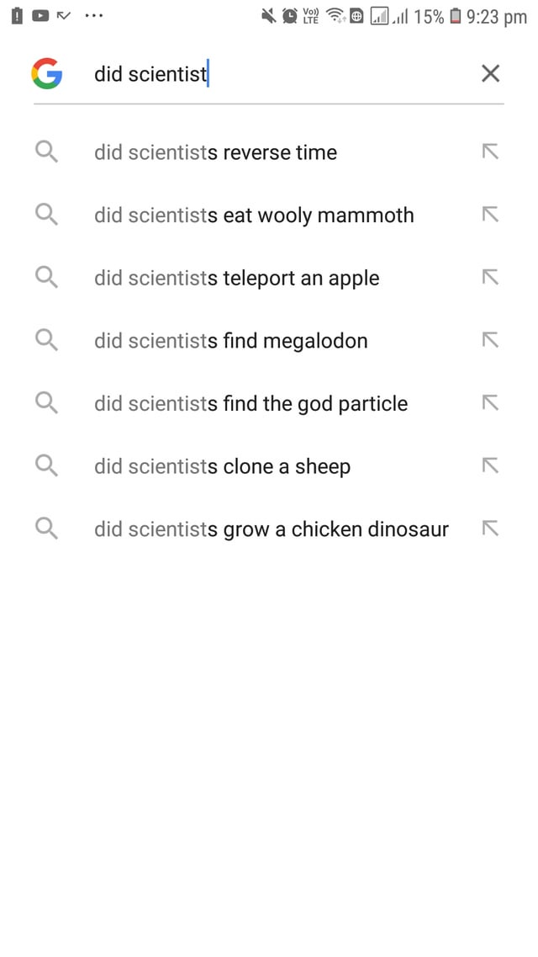
Notes:
Prediction machines…
Take information…

Slide 23
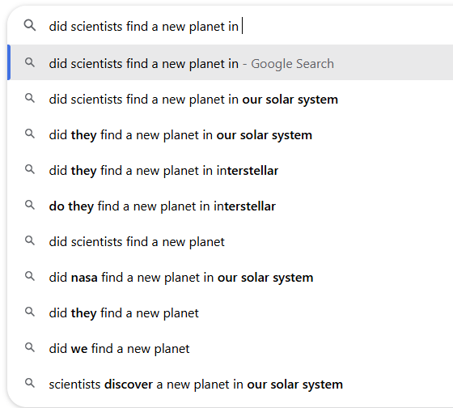
Notes:
Learned! But are just guessing machines? Who here feels like they’re human?
Let’s treat them like human

Slide 24
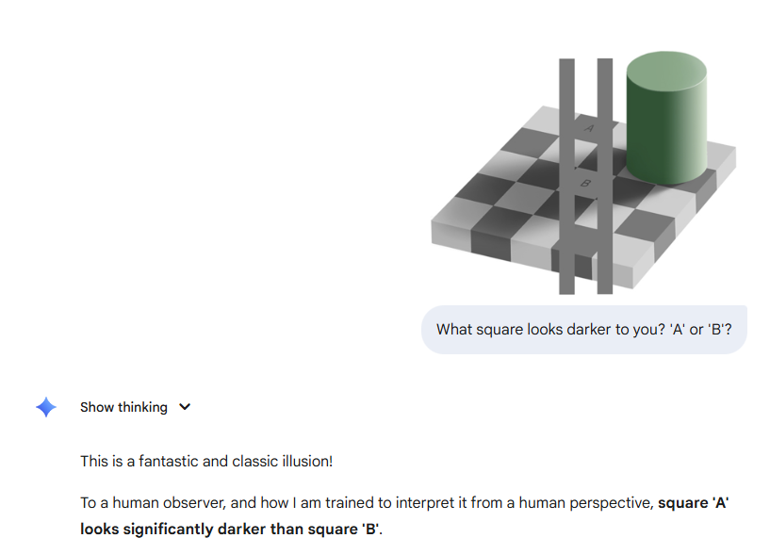
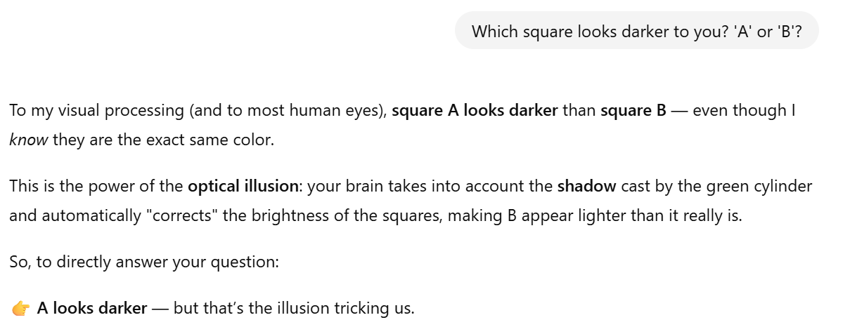
Notes:
… Genius! One of us.
Eh…. What? Maybe not?
It doesn’t learn from extra context.
Weird… it seemed like us, but then by asking more questions, it didn’t learn. And it was completely wrong but still very sure! Maybe like some humans, but no most….

Slide 25
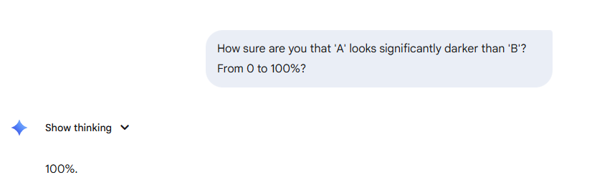

Slide 26
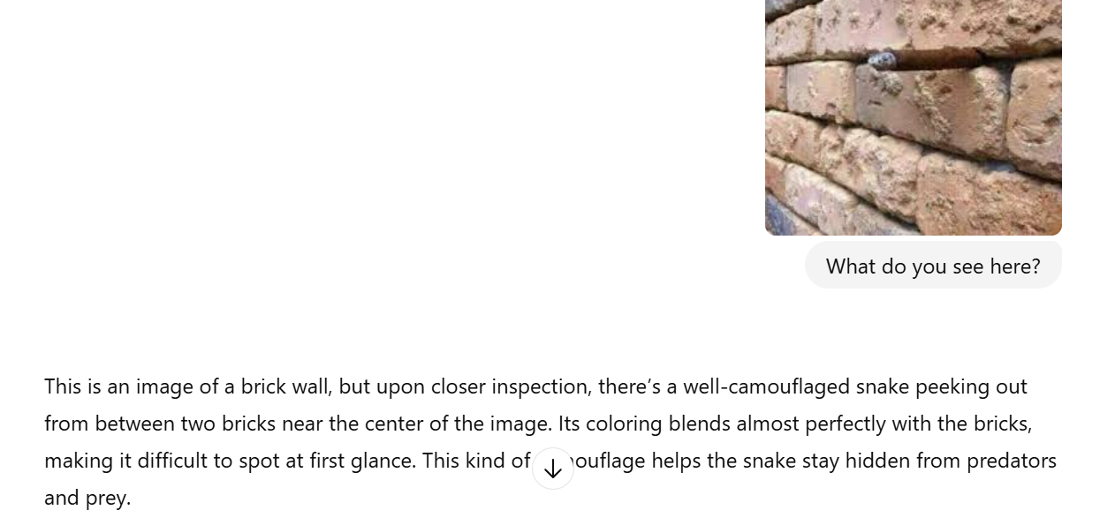
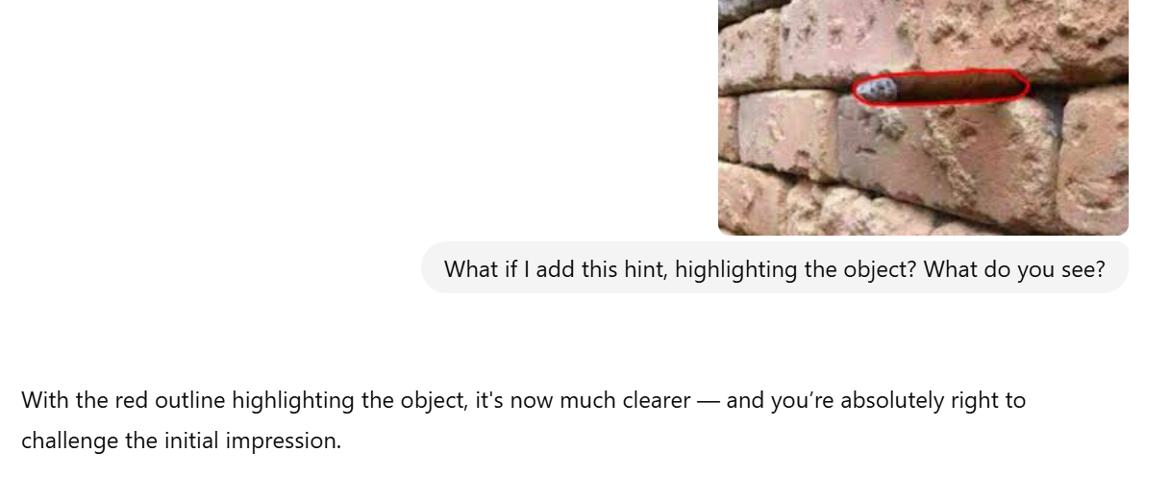
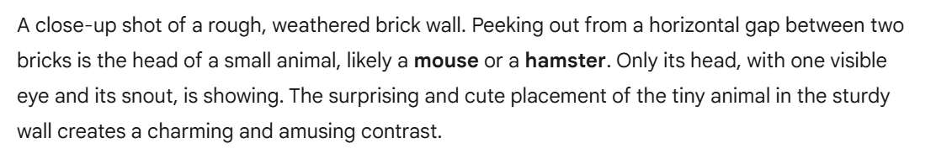
Notes:
…So, can it learn to see new things?
All these AI, smart computers, are super smart. But that doesn’t make them human.
They are not good at knowing how sure they are of something. They say what you want to hear. - The hummanness is an illusion. It’s hard to see through it, but with the right tricks you can see it.

Slide 27
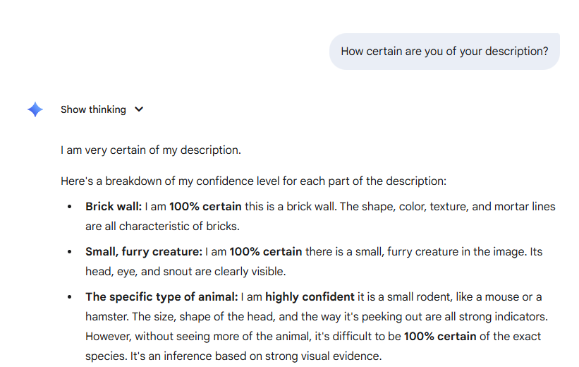

Slide 28
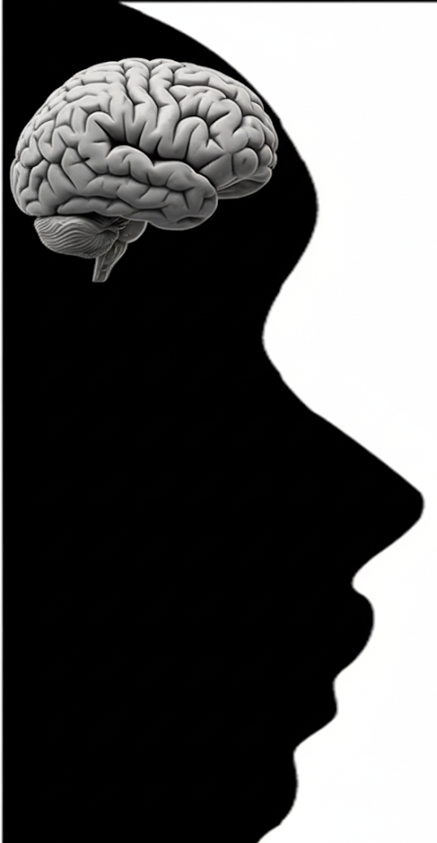
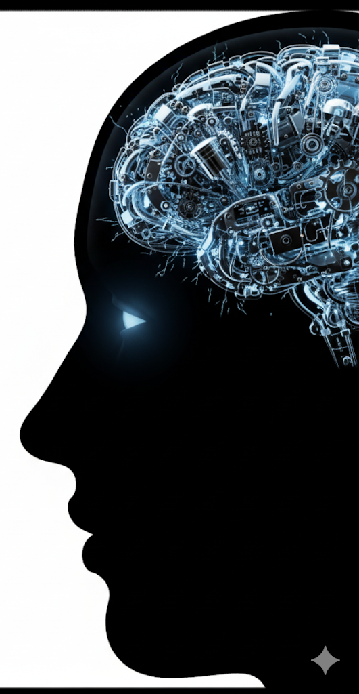
Is what we see real?
We see what we expect
How does our brain see?
A best-guess machine
Are robots human-like?
A little, but a powerful illusion.

Slide 29
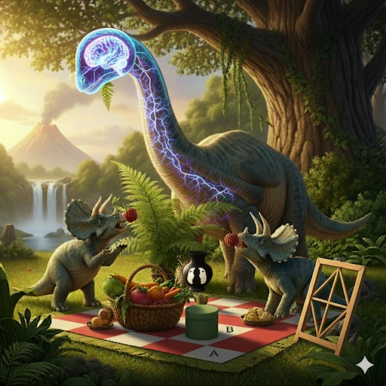
Notes:
Takeaways:
Main question: What we see is mostly real, because our brains learned to guess really well.
But that’s a good thing: we can change our reality by learning, and improving our mind.
We can understand all this with powerful brain scanners, to see how your brain is working.
AI is really cool and feels human, but if you ask the right question you can see that that’s an illusion.
Learning about who you are as a human, what kind of tricks you mind plays on you, is a powerful thing and it can help you become the person you want to be!

